Slide 1
“Another Hitchcock-and-bull story in which the mystery is not so much who done it as who cares.” -- Time
“One is agreeably used to Hitchcock repeating his effects, but this time he is repeating himself in slow motion.”
--Penelope Houston

Slide 2
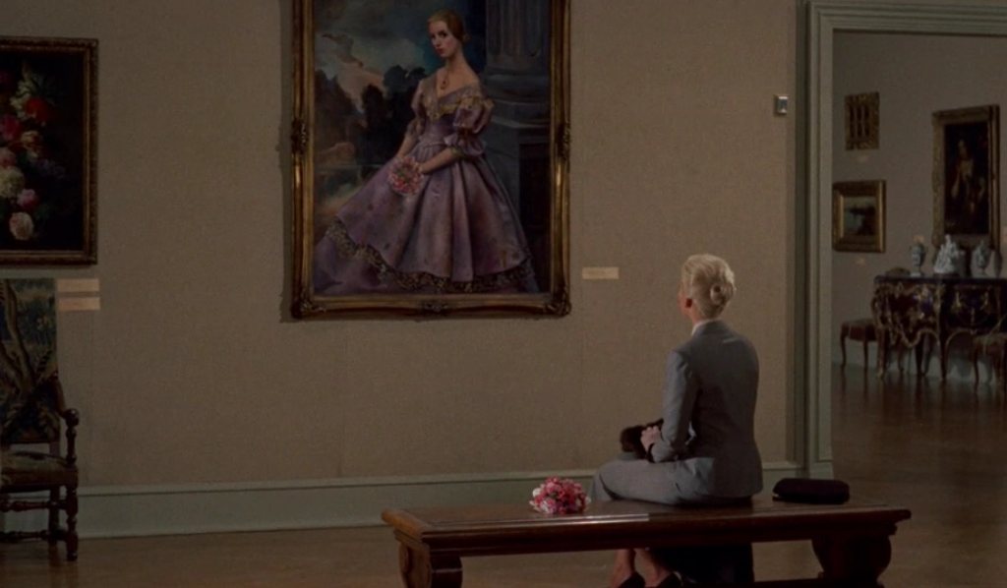
ENGL 2350’s “Portraits of Carlotta”

Slide 3
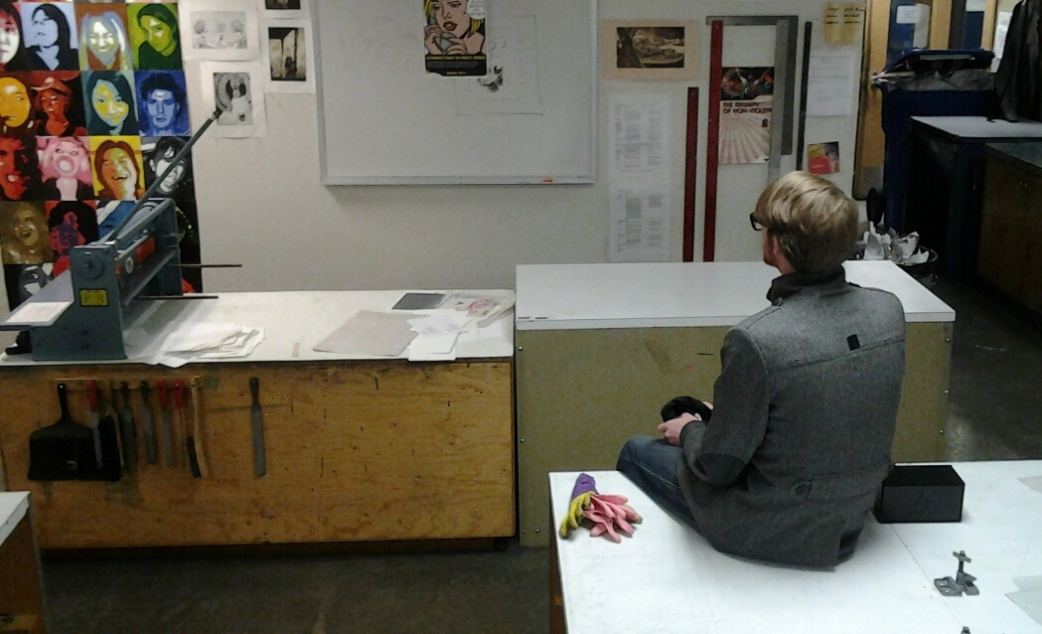

Slide 4
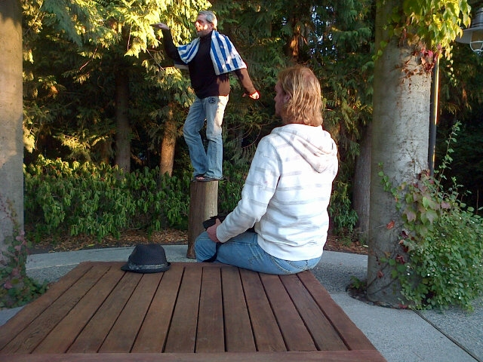

Slide 5
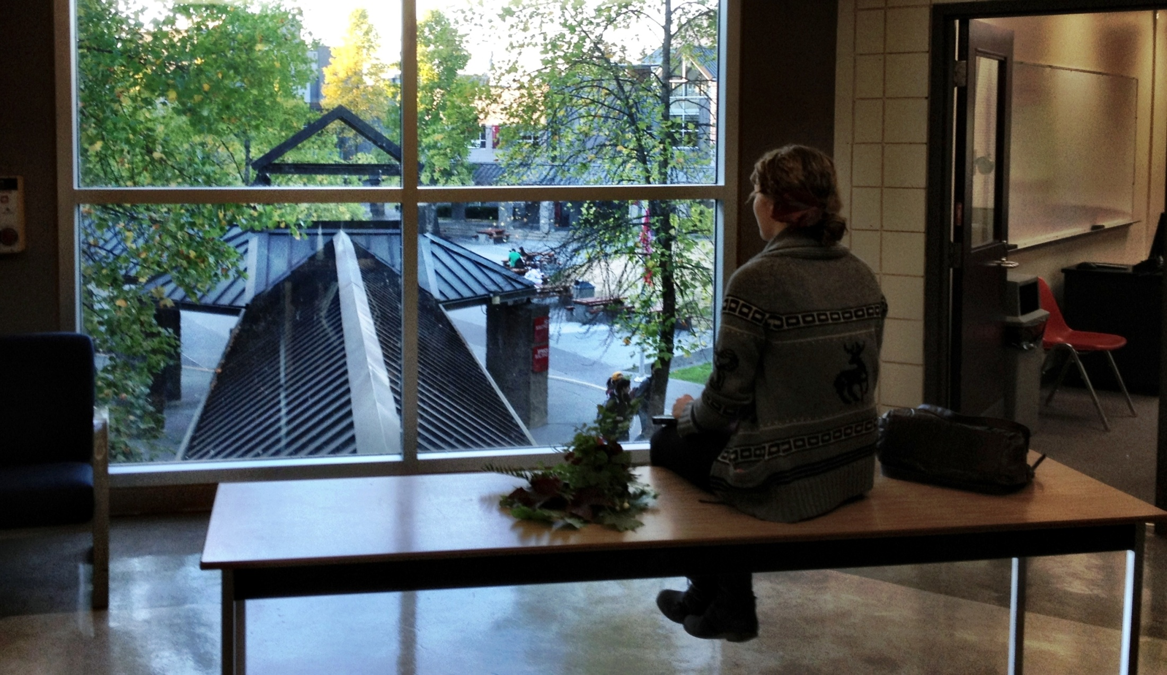

Slide 6
